Slide 1
Change and Change Strategies

Slide 2
Three Change Strategies
Power / Coercive
Rational / Economic
Normative / Re-educative

Slide 3
“The opposite of a deeply held truth is not a lie, but another deeply held truth.”
Neils Bohr, Physicist

Slide 5
Polarity Management
“If you want to teach people a new way of thinking, don’t bother trying to teach them. Instead, give them a tool, the use of which will lead to new ways of thinking.”
Buckminster Fuller
Polarity Management
Identifying and Managing Unsolvable Problems
Developed by Barry Johnson, PhD

Slide 6
Polarities in Healthcare
Quality and Cost
Stability and Change
Patient needs and Staff needs
Team and Individual
Independent Business Units and Integrated Business Units
Safety and Freedom
Candor and Diplomacy
Unconditional Respect and Conditional Respect
Work and Home
Impact and Intent

Slide 7
Problem or Polarity
Is the difficulty ongoing, like breathing?
Are there two alternatives that in interdependent, meaning you can only focus on one pole for so long before you are required to focus on the other pole, like inhaling and exhaling?
Is it necessary , over time, for you to have both identified upsides?
Will focusing on one upside to the neglect of the other eventually undermine your efforts to move toward your higher purpose?
A “yes” answer to any of these questions suggests this is probably a polarity to manage.
A “no” answer to all of these questions suggests that this is probably a problem to solve.

Slide 8
Change Efforts
All change efforts are more effectively seen as part of a polarity map and process
The polarity will be:
Unavoidable
Unsolvable
Indestructible

Slide 9
Change Efforts
All change efforts are more effectively seen as part of a polarity map and process
Treating a polarity as if it were a problem to solve
Reduces the attainability
Slows down the process by increasing resistance
Even If the resistance is overcome, the goal of the change is inherently unsustainable.

Slide 10
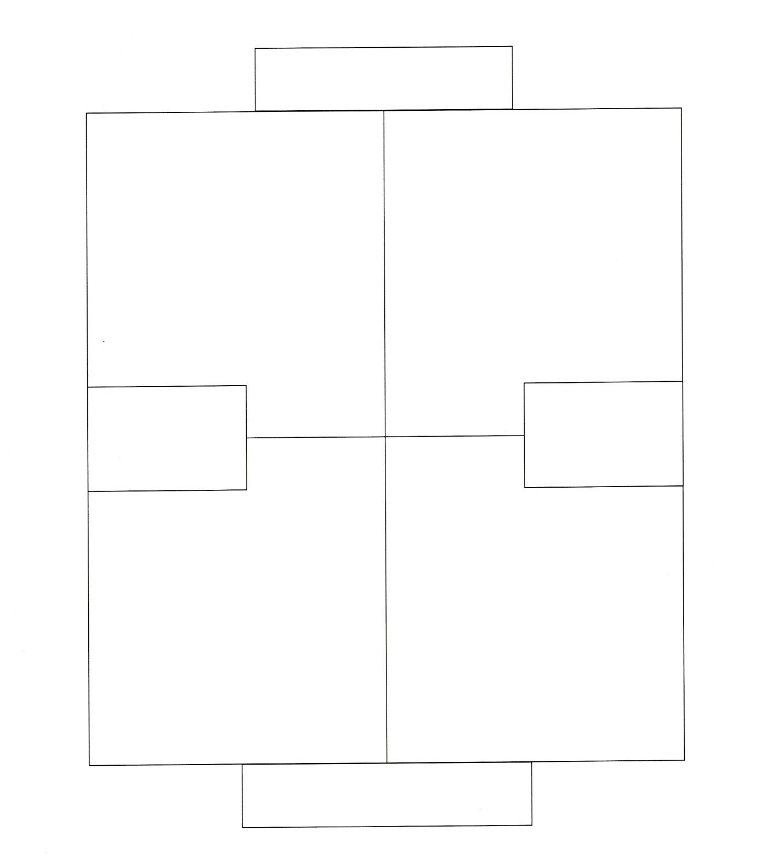
Higher Purpose
Positive results of focusing on left pole.
Positive results of focusing on right pole.
Left Pole
And
Right Pole
Negative results of over-focusing on left pole.
Negative results of over-focusing on left pole.
Deeper Fear

Slide 11
Life
Get Oxygen
Clean out carbon dioxide
Inhale
And
Exhale
Too much carbon dioxide
Too little oxygen
Death

Slide 12
Point-Of-View Exercise
Team A –You are very concerned that your nursing home spends more time focusing on the interests of the residents than the interests of the nursing home. You are about to debate a group that is adamant about focusing on the interests of the residents.
Team B – You are very concerned that your nursing home spends more time focusing on the interests of the nursing home than the interests of the residents. You are about to debate a group that is adamant about focusing on the interests of the nursing home.

Slide 13
Point-Of-View Exercise
Step 1 = Preparation
With the help of your fellow team members, brainstorm arguments supporting the value of your position and the downside risks of the opposing position.
Step 2 = Debate the opposing group
Two Objectives:
Hold on to your own point of view
Get the other team to agree with your point of view.

Slide 14
Team A
Positive results of focusing on the nursing home interests
?
Nursing home interests
Resident/
Family Interests
Negative results of over-focusing on the resident/family interests to the neglect of nursing home interests
?

Slide 15
Team B
Positive results of focusing on the resident/family interests
?
Nursing home interests
Resident/
Family Interests
Negative results of over-focusing on the nursing home
interests to the neglect of resident/family interests
?

Slide 16
Thriving Nursing Home and Thriving Residents/Families
Step 1: Agree on 4 positive results of focusing on nursing home interests
Step 2: Agree on 4 positive results of focusing on resident/family interests
Nursing home interests
Resident/
Family Interests
Step 3: Agree on 4 negative results of over-focusing on nursing home interests to the neglect of resident/family interests
Step 4: Agree on 4 negative results of over-focusing on resident/family interests to the neglect of nursing home interests
Declining Nursing Home and Residents/Families

Slide 17
The Polarity Management Process
Include key stakeholders
Define the difficulty
Build the polarity map
Understand how this polarity works
Develop action plan to gain/maintain both upsides
Implement red flag indicators
Assess, monitor and course correct

Slide 18
Basic Action Steps to Manage a Polarity Well Over Time
Higher Purpose
Action Plan
1.
2.
3.
4.
When, what? By what date or frequency?
1.
2.
3.
4.
Positive results of focusing on left pole.
Positive results of focusing on right pole.
Action Plan
1.
2.
3.
4.
When, what? By what date or frequency?
1.
2.
3.
4.
Red Flag Indicators?
Who Will Know?
What Will They Do?
Red Flag Indicators?
Who Will Know?
What Will They Do?
Negative results of over-focusing on left pole.
Negative results of over-focusing on left pole.
Deeper Fear

Slide 19
Regional Collaboratives Action Plan
Overall goal: We want to improve:______________
__________________________________________
SPECIFIC DELIVERABLES: What needs to be done to accomplish our goal? | CRITICAL LINKAGES: Who needs to be involved within and outside the organization? | PERSON RESPONSIBLE: Who will ensure this deliverable is completed? | ACTION STEPS: What specific steps need to be taken? | PLAN FOR MONITORING PROGRESS: Who will monitor? How will we monitor? | TARGETED DATE FOR COMPLETION:

